Slide 1
London by Edward Rutherfurd
An Introduction

Slide 2
Historical Fiction
Tells a story that is set in the past. That setting is usually real and drawn from history, and often contains actual historical persons, but the main characters tend to be fictional. Writers of stories in this genre, while penning fiction, attempt to capture the manners and social conditions of the persons or time(s) presented in the story, with due attention paid to period detail.

Slide 3
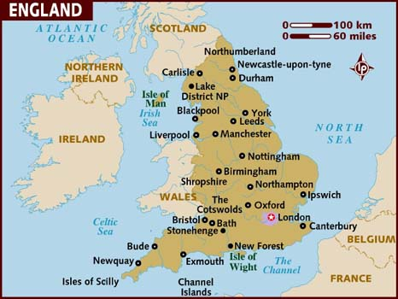
Map of Britain

Slide 4
Place Names
In “The River” Londinos is the name the Celts have given to the area on the Thames that eventually becomes London. Why has the name remained so similar? As immigrants and invaders move into a new area, they will ask the locals the names of rivers, villages, and other geographical locations and thus the name becomes a part of their own language. As you read London, you will note that although there may be slight derivations, the various forms of London are always recognizable.

Slide 5
From the beginning…
Rutherfurd reveals the history of London from the arrival of Julius Caesar to the twentieth century. He tells the sweeping story of the struggles, successes, joys and sorrows of a half-dozen families who bear witness to the rise of a great city over the course of seventeen hundred years. And it all begins with “The River”. . .

Slide 6
. . .Thames
Every great city has one thing in common – it resides on or near a river. For London, that is the River Thames, which seeps out of the earth in a Gloucestershire field near Cirencester. Two hundred and fifteen miles and six counties later, it is swallowed by the North Sea.

Slide 7
The Thames
…is a tidal river, which means it is affected by the ocean tides. The river rises and falls upwards of 10 feet twice a day. As the tide comes in, it reverses the current of the Thames to flow upriver, then when the tide goes back out, the current returns to normal.
This makes an excellent situation for ocean-going vessels seeking access inland.

Slide 8
Setting and Time Period
All events in London center on London itself. Rutherford has chosen to concentrate on specific time-periods in which influential changes took place in England. As we study these time-periods, we will read the chapters from London associated with them. For instance, the Anglo-Saxon period, our first unit of study, includes the chapters “Londinium,” “The Rood,” and “The Conqueror.”

Slide 9
Characters
The families we meet in these chapters tend to have unique traits that appear from one generation to the next. As you read, make note of the characters and their unique traits.
The families we meet in the Anglo-Saxon chapters are:
Ducket
Bull
Barnikel
Silversleeves

Slide 10
How to Read London
Pay attention to:
Characters and their traits
Setting and important place names
Plot
Historical events
References to historical figures (e.g. Caesar, Edward the Confessor, William the Conqueror, etc.)
Social and religious changes

Slide 11
Quiz Format
So how are you going to be quizzed? Here are some sample questions from the first chapter “The River.”
Who are the main inhabitants of England in this chapter?
What identifying hereditary features does Segovax have?
What bargain has Segovax’s mother, Cartimandua, made with the soldier?
What prophecy does the Druid share with Cartimandua?

Slide 12
Quiz Cont.
Segovax’s father dies in battle; eventually, Segovax is able to find his father’s body. Name one of the two items he removes from his father’s corpse.
How is this incident where the Roman soldiers come across Segovax after he finds his father’s body reminiscent of Uhtred’s experience in The Last Kingdom?
When Segovax seems unable to get past his grief over his father’s death, the old Druit performs a ritual to end the grief and allow Segovax to get on with his life. What is the ritual?

Slide 13
“Londinium”
Begin reading the chapter “Londinium” and annotate as you read.

